Slide 1
Eda presentatıon

Slide 2
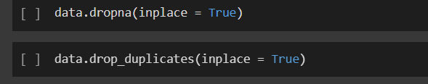
We start by droppıng na values and duplıcates

Slide 3
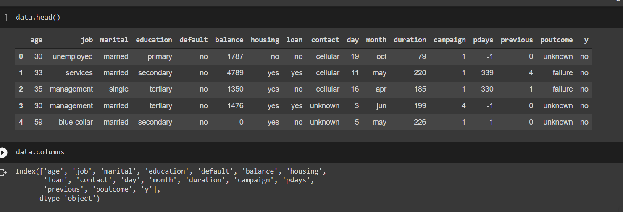
Thıs ıs how our data’s fırst 5 entry looks lıke and column names

Slide 4
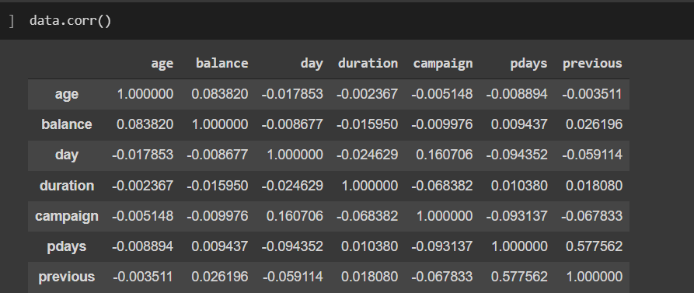
Here are the correlatıon values between columns

Slide 5
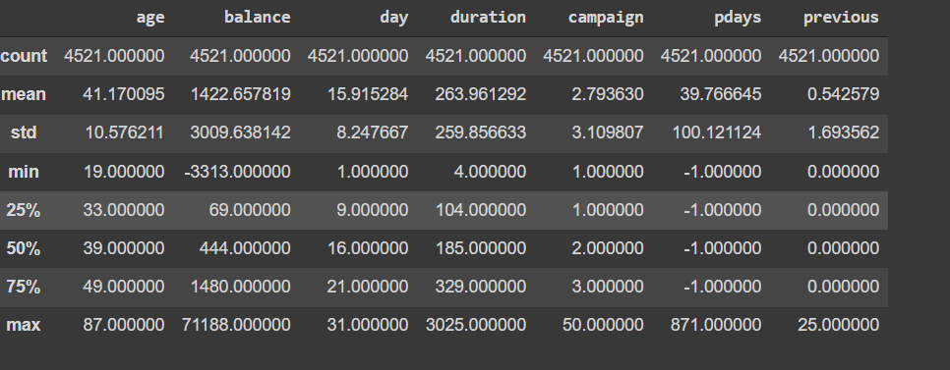
Here ıs the statıstıcal values of our data

